Slide 1
Addis Ababa Science and Technology University
College of Engineering
Department of Software Engineering
Introduction to Software Engineering and Computing
(SWEG2101)
Title
Impact of Software on economic societal and
environmental safety
Group Assignment
Group 2 Section: B
Group Members ID.No
1. Helen Mulugeta ETS0719/17
2. Helen Tamene ETS0720/17
3. Henok Ayenew ETS0727/17
4. Hermela Tilahun ETS0741/17
5. Hermon Ermias ETS0742/17
6. Hilina Moges ETS0748/17
Submitted To: Dr. Melak
Submission Date: October 26,2025

Slide 2

Impact of Software on the Global Economy
Software reshapes how businesses compete, how services are delivered, and how people work.

Slide 3

Job Creation: Scale and Scope
Software generates both direct employment and cascading indirect opportunities across the economy.
2.5M
9.8M
$1.07T
Direct Software Jobs
Total Jobs Supported
Economic Value Added
Developers, data scientists, product managers, security specialists, and UX designers.
Including indirect effects across suppliers, professional services, and deploying industries (2014 U.S. data).
Software's contribution to U.S. economy, with $475.3B directly from software firms.

Slide 4

Platform Ecosystems & Entrepreneurship
Software platforms enable freelance, gig, and platform-enabled entrepreneurship, creating new pathways for independent workers and startups to reach markets and scale rapidly.

Slide 5


Innovation: Speed and Access
Compressed Development Cycles
Rapid prototyping and A/B testing enable faster iteration and market response.
Data-Driven Improvement
Continuous product refinement based on real user behavior and feedback.
Lower Entry Barriers
Open-source libraries and shared cloud infrastructure reduce startup costs and accelerate scaling.

Slide 6
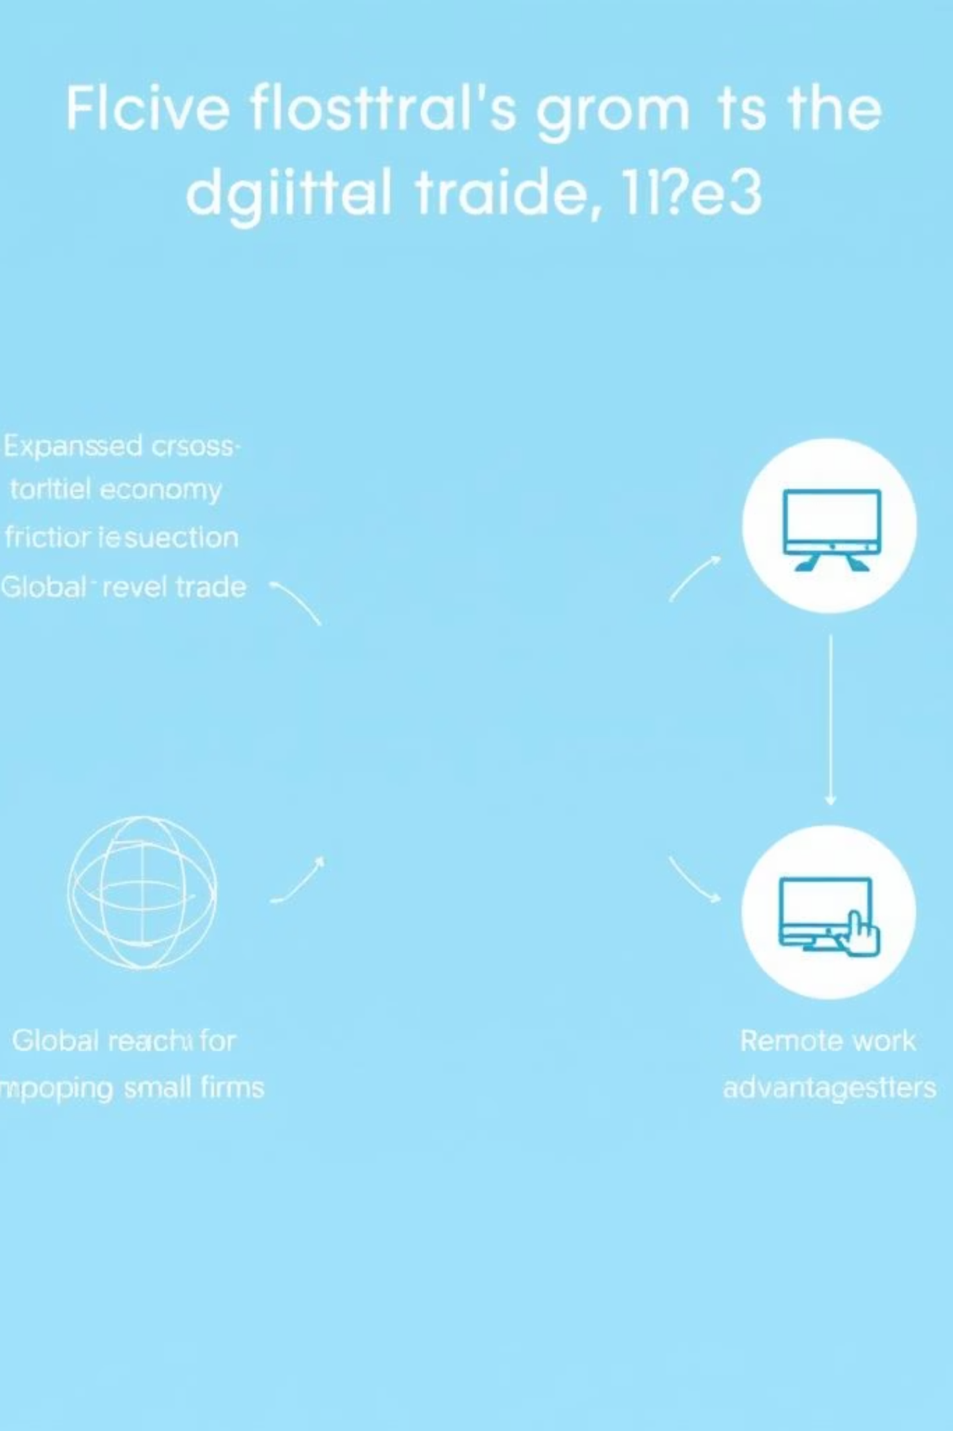
Digital Economy Expansion & Global Trade
Cross-Border Friction Reduced
Global Reach for Small Firms
Remote Work Advantage
Broader talent sourcing and new services trade opportunities across geographies.
Cloud platforms and SaaS lower barriers for international transactions and service delivery.
Digital marketplaces enable small businesses to access customers worldwide with minimal upfront investment.

Slide 7

SaaS and Cloud Adoption Growth
U.S. software services spending projected to rise 10.7% in 2025, reflecting accelerating adoption of SaaS and cloud tools across enterprises and small businesses.

Slide 8
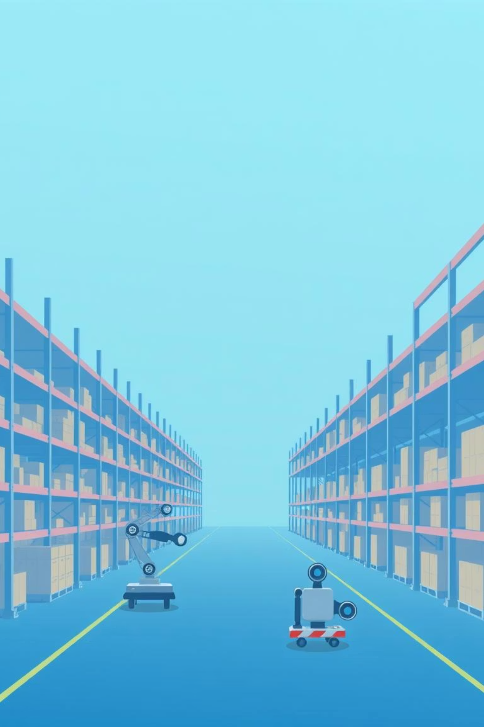
Cost Reduction & Productivity Gains
01
Automation
Eliminates repetitive tasks and reduces human error.
02
Process Standardization
Improves forecasting and optimizes supply chains.
03
Output Per Worker
Increases productivity and reduces waste across operations.
04
Subscription Pricing
Shifts capital costs to predictable operating expenses, enabling smaller firms to access advanced capabilities.

Slide 9

Conclusion
Software acts as both foundation and accelerator of global economic transformation. Its primary impacts—job creation, innovation, digital trade expansion, and cost reduction—are mutually reinforcing and compound over time.

Slide 10
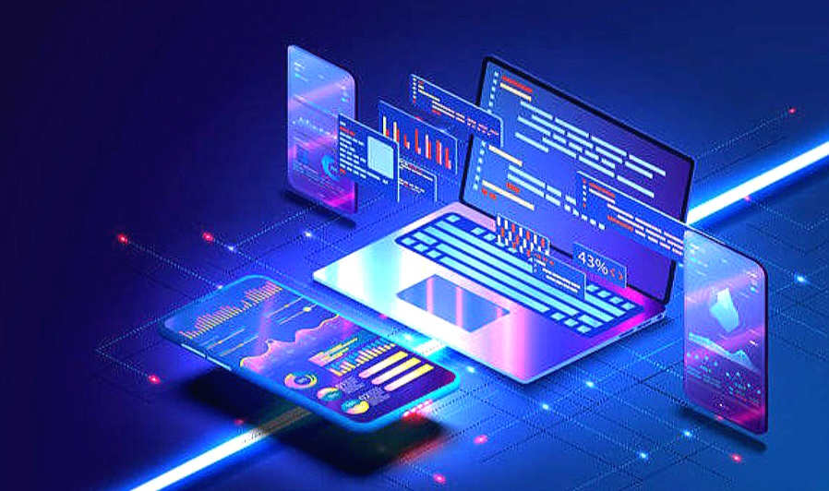
IMPACT OF SOFTWARE ON SOCIETY

Slide 11


Software impact society by making life easier and more convenient through the programs and applications created.
“SOFTWARE IS EATING THE WORLD.”
Has both positive and negative impact.

Slide 12



POSITIVE IMPACTS
Learning - information has become more accessible
Communication - faster connection
Professional life - remote jobs, online meetings
Costs - reduced cost
Fun - games, social media, music

Slide 13



NEGATIVE IMPACTS
Physical health - eye and back strain, mental health issues.
Children and exposure to adult material
Addiction
Personal life - less interaction with people
Professional life - less interaction with colleagues, classmates, job replacement.
Digital divide - inequality between people with and without access and necessary skills.
Privacy and security risks
Spread of misinformation

Slide 14
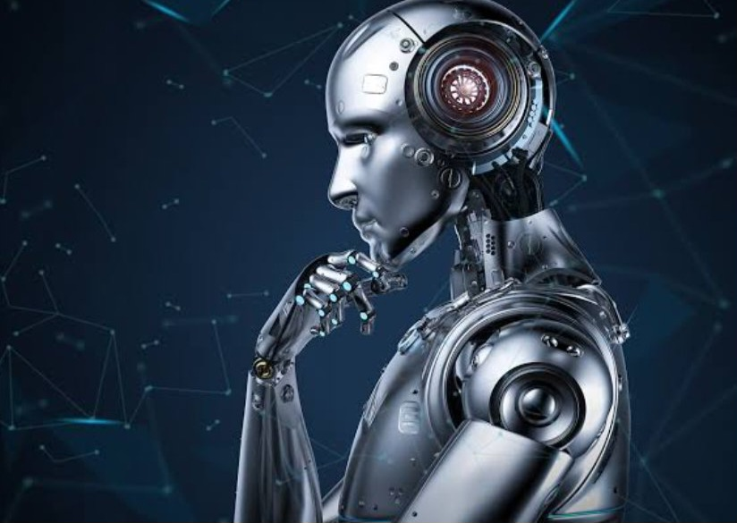
AI is a form of software and technology that simulates human intelligence in machines having a transformative impact on the society. It has benefits like increased efficiency and personalized experience while also raising concerns about job displacement, privacy and ethical challenges.

Slide 15

What to expect in the future:
Research from Oak Ridge National Laboratory maintains their is a high probability of AI replacing software developers by 2040.
Rate of innovation could increase drammatically, with a potential of 50 to 100 years of progress within the next 5 to 10 years.
More sophisticated software and data collection can threaten individual privacy and security.
As we move forward:
A thoughtful approach to software safety and governance is crucial.
Individuals and businesses need to invest in retraining and upskilling to adapt to the changing job market.
There will be a greater need to balance innovation with creating products that don’t create undue complexity for users and their workflows.

Slide 16

The Impact of Software on Environmental Safety
Understanding how technology shapes our planet's future
Hermela TilahunIntroduction to Software Engineering and Computing27 October 2025

Slide 17

The Digital Paradox
Enhanced Connection
Software powers global communication and innovation
Hidden Costs
Technological progress carries environmental consequences
Balancing progress with sustainability requires understanding both sides of this equation.

Slide 18
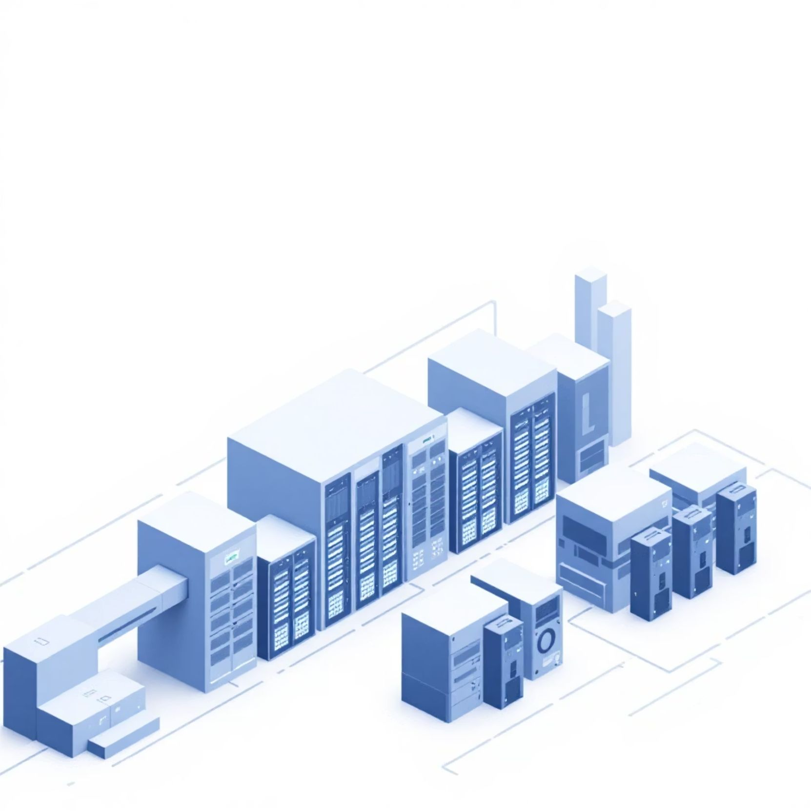
Energy Consumption: The Silent Drain
Data Centres Demand Enormous Power
Global data centres process billions of transactions daily, requiring continuous electricity supply.
ICT Sector Impact
Approximately 14% of global greenhouse gas emissions
Growing faster than many other industries
Cooling systems consume vast quantities of water

Slide 19

E-Waste: The Accumulating Problem
1
Software Updates Trigger Hardware Upgrades
Continuous software improvements push older devices beyond their capability
2
Toxic Materials Released
Discarded electronics leak hazardous substances including mercury, lead, and cadmium into soil and water
3
Growing Global Crisis
Millions of tonnes of e-waste generated annually, with only a fraction properly recycled

Slide 20
Additional Environmental Risks
Bloatware Burden
Data Centre Cooling Crisis
Inefficient code increases memory demands, forcing hardware upgrades and consuming more energy throughout device lifecycle
Preventing server overheating requires massive water consumption and energy-intensive cooling infrastructure
These interconnected challenges demonstrate why sustainable software design matters

Slide 21
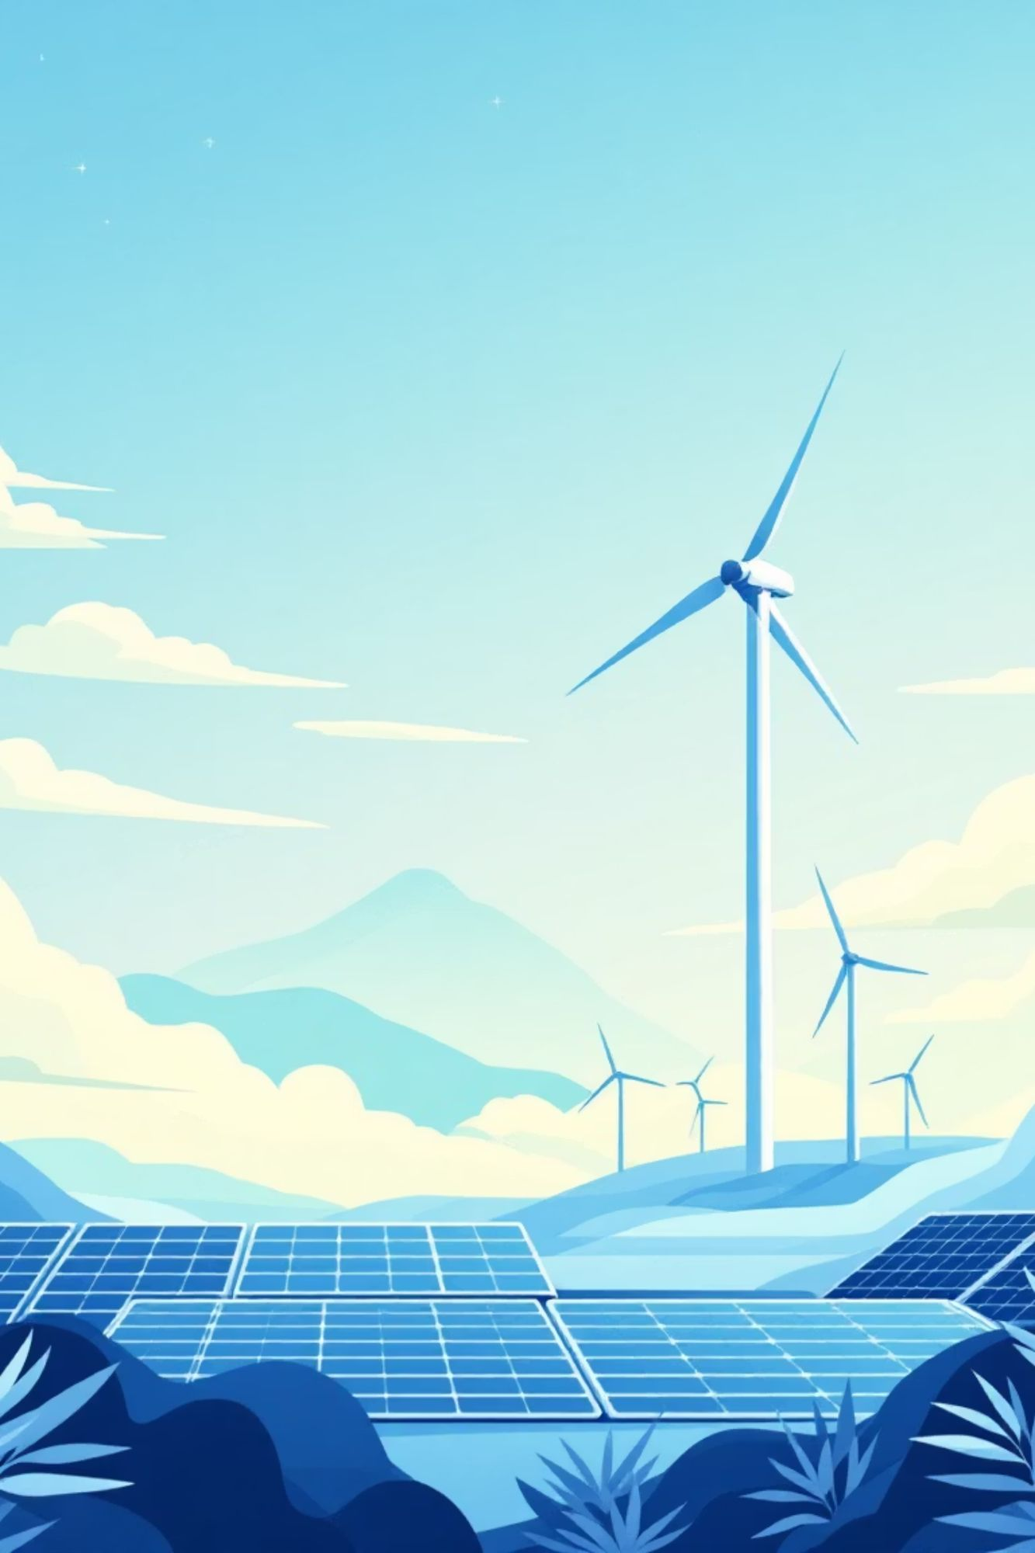

Green Software: Part of the Solution
Energy-Efficient Code
Optimising algorithms and removing unnecessary processes directly reduces power consumption
Cloud Infrastructure
Shared computing resources improve efficiency and reduce individual resorce waste
Intelligent Systems
Software innovations enable environmental monitoring, precision agriculture, and intelligent resource management

Slide 22
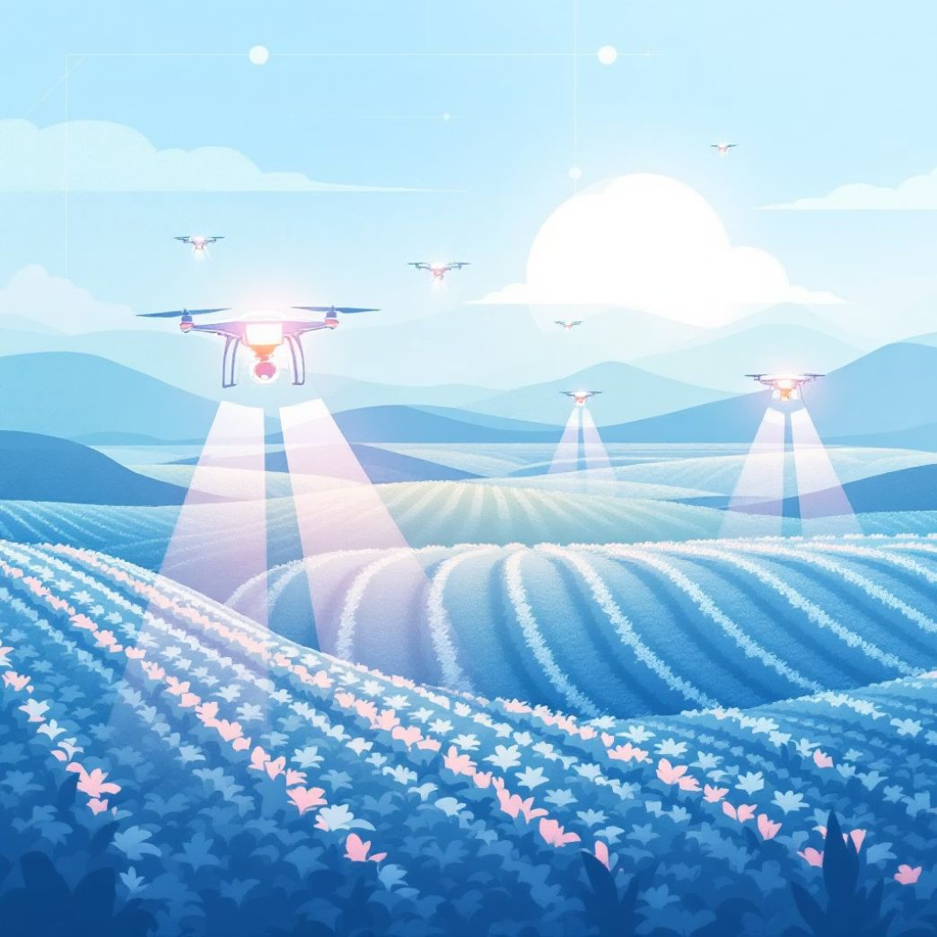
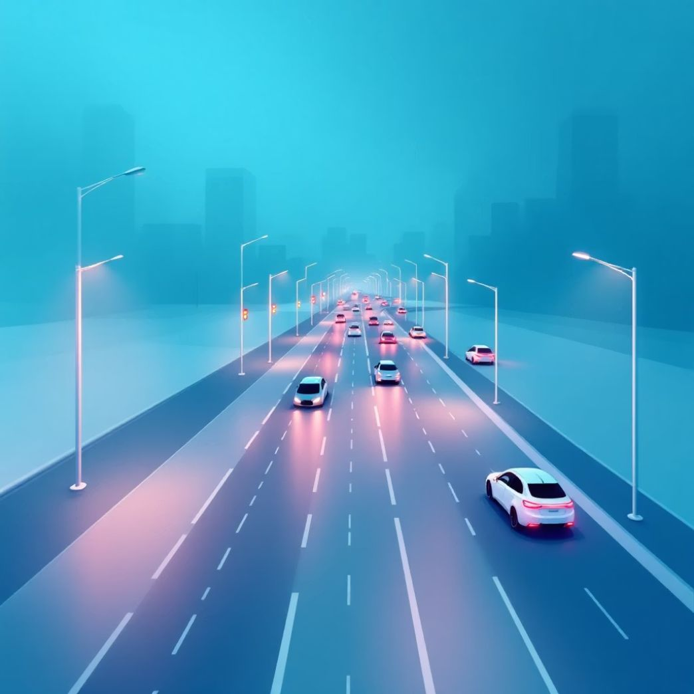

Software Enabling Sustainability
Smart Agriculture
Intelligent Transportation
Smart Building Management
Optimising water use and reducing chemical inputs through data-driven farming
Reducing congestion and fuel consumption through optimised routing and autonomous systems
Minimising energy waste through automated climate and lighting control systems

Slide 23
Building Sustainable Software Practices
Advocate for Policy
Measure Impact
Support regulations and industry standards promoting green software engineering practices
Design with Efficiency
Track energy consumption and hardware efficiency metrics throughout the lifecycle
Prioritise energy-efficient architecture from the beginning of development

Slide 24

The Responsibility of Engineers
Sustainable software development is not optional—it is essential.
Every line of code written today shapes environmental outcomes tomorrow. Software engineers possess the knowledge and responsibility to design systems that balance innovation with environmental safty.

Slide 25




Conclusion: Technology for a Sustainable Future
Real Challenges
Our Role
Software significantly impacts energy, waste, and resource consumption
Responsibly designed software enables environmental innovation and efficiency

